Slide 1

Pre-training of Deep Bidirectional Transformers for Language Understanding
1
B.E.R.T.
Colin Kirby – co201115@ucf.edu

Slide 2

Why BERT was Needed in NLP.
2
What is BERT ?
BERT = Bidirectional Encoder Representations from Transfomers
Why This Problem Matters :
NLP tasks need full context – one-way models fall short.
What Existed before BERT :
ELMo : Shallow use of both directions, no deep bidirectionality.
Lack of context $→$ Poor results on QA and inference tasks.
Problem With These Methods :
Incomplete context hurts performance on key tasks like QA and NLI.
Notes:
Notes :
NLP – Natural Language Processing, focuses on how machines can understand human language.
Lack of context – Refers to how previous models approach NLP, such as GPT with unidirectional.
QA – Question Answering, So for NLP, given a paragraph, can the model answer a question based off it ?
Inference – Can the model understand if one sentence logically follows from another ?

Slide 3
Problem Statement.
3
BERT
Main Goal :
Build a single model that works across many NLP tasks.
Learn deep, bidirectional context representations.
Enable fine-tuning with minimal task-specific changes.
QA Task
NLI Task
Sentiment Task
Research Question :
Can a masked language model be pre-trained effectively to boost performance on a wide range of NLP tasks?
Notes:
Notes :
BERT comes in to build a single model that can take deep context, work with minimal fine-tuning, and perform well across a series of NLP tasks.
The question was if it was really possible ?
QA – Question Answering – SAT Questions type of stuff.
NLI – Understanding if language makes sense.
Sentiment – Determining Emotion from Language.

Slide 4
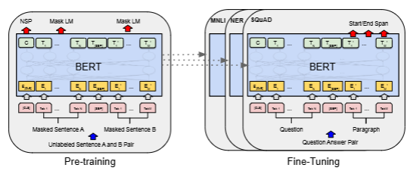
How BERT Learns Language.
4
Two-Stage Training Framework.
1. Pretraining :
Learn from unlabeled text corpora.
Two Tasks :
Masked Language Modeling (MLM) : Randomly Mask 15% of Tokens & Predict Them.
Next Sentence Prediction (NSP) : Predict if sentence B follows sentence A.
2. Fine-tuning :
Adapt the pre-trained model to specific NLP tasks.
Minimal architecture changes (Just adds tasks specific heads).
Notes:
Notes :
Pretraining works upon a large collection of texts that are unlabeled.
MLM – Randomly Masking Words and Predicting Them, Using Loss to nudge in proper direction of correct answers.
NSP – Predicting if Sentence B follows Sentence A, returning 0 / 1 for if it does or not.
Fine-tuning comes in for the User, it allows the model to adapt to more specific NLP task with minimal architecture changes required.
Simplify adding stuff like “Here’s how you tell if a sentence is happy or sad” prior to the output, for sentiment training specifically.

Slide 5
Core Contributions of BERT
5
Masked Language Modeling (MLM).
Enables deep bidirectional learning from unlabeled text.
Next Sentence Prediction (NSP).
Helps model sentence-level relationships.
One model, many tasks.
Works on 11+ NLP tasks with minimal changes.
Open source + Pre-trained release.
Made large-scale NLP accessible & reproducible.
Notes:
Notes :
MLM – Works both ways, more context, better learning.
NSP – Better at modeling relationships between sentences with better contexts.
1 Model – Can do many task with minimal changes required.
Open Source – Made Large scale NLP accessible & reproducible.

Slide 6
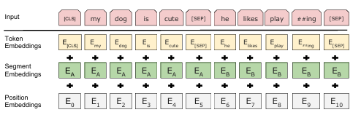

Technical Details of BERT
6
Input = Token + Segment + Position
Words + Sentence IDs + Word Order
All summed $→$ fed into Transformer Encoder.
Pre-training = MLM + NSP
15% masked token :
80% [MASK]
10% Random
10% Unchanged
Model | Layers | Hidden Size | Heads | Params
BERT_BASE | 12 | 768 | 12 | 110M
BERT_LARGE | 24 | 1024 | 16 | 340M
Next Sentence Prediction : 50% Actual Next Sentence, 50% Random Pairing
Notes:
Notes :
Token Embedding – Actual meaning of the word, breaking down sentence to individual words.
Segment Embedding – Sentence IDs, stored integers to differentiate sentences.
Position Embedding – As transformers don’t understand order, BERT adds position vectors to make sure the model knows when which word came in order.
Summed into one Vector, passed to transformer encoder to understand context and output a super rich contextual embedding for each word, understanding both meaning and context.
MLM – Randomly select 15% of words, 80% of time, replace with [MASK], 10% completely change word, 10% unchanged but makes model think word might be masked so it still has to predict it.
NSP – 50% of time it is the correct sentence, 50% of time its not.

Slide 7
Technical Details of BERT
7
1. GLUE Benchmark ( 8 NLP Tasks )
BERT_LARGE Avg. : 82.1
GPT Avg : 75.1 (+7 pt gain across diverse tasks)
2. SQuAD Question Answering
v1.1 F1 Score :
Single : 90.9
Ensemble : 93.2 (better than human-level)
3. SWAG ( Commonsense Inference )
BERT_LARGE outperformed ELMo by +27.1%
Notes:
Notes :
GLUE – A collection of 8 different NLP tasks, like sentiment analysis, sentence similarity. Standardized test for NLP models. Outperformed GPT by +7 Points.
SQuAD – A reading comprehension task, reading a paragraph and answering questions based on it.
V1.1 is an easier version of SQuAD where every question has an answer in the passage.
V2.0 is a harder version where some questions have no answer.
Scores for SQuAD are the overlap between the predicted vs real-answer. Better than human level at around 91.2.
SWAG – A commonsense task, given Sentence A, choose Sentence B out of 4 Options. Beats ELMO by +27.1%.

Slide 8
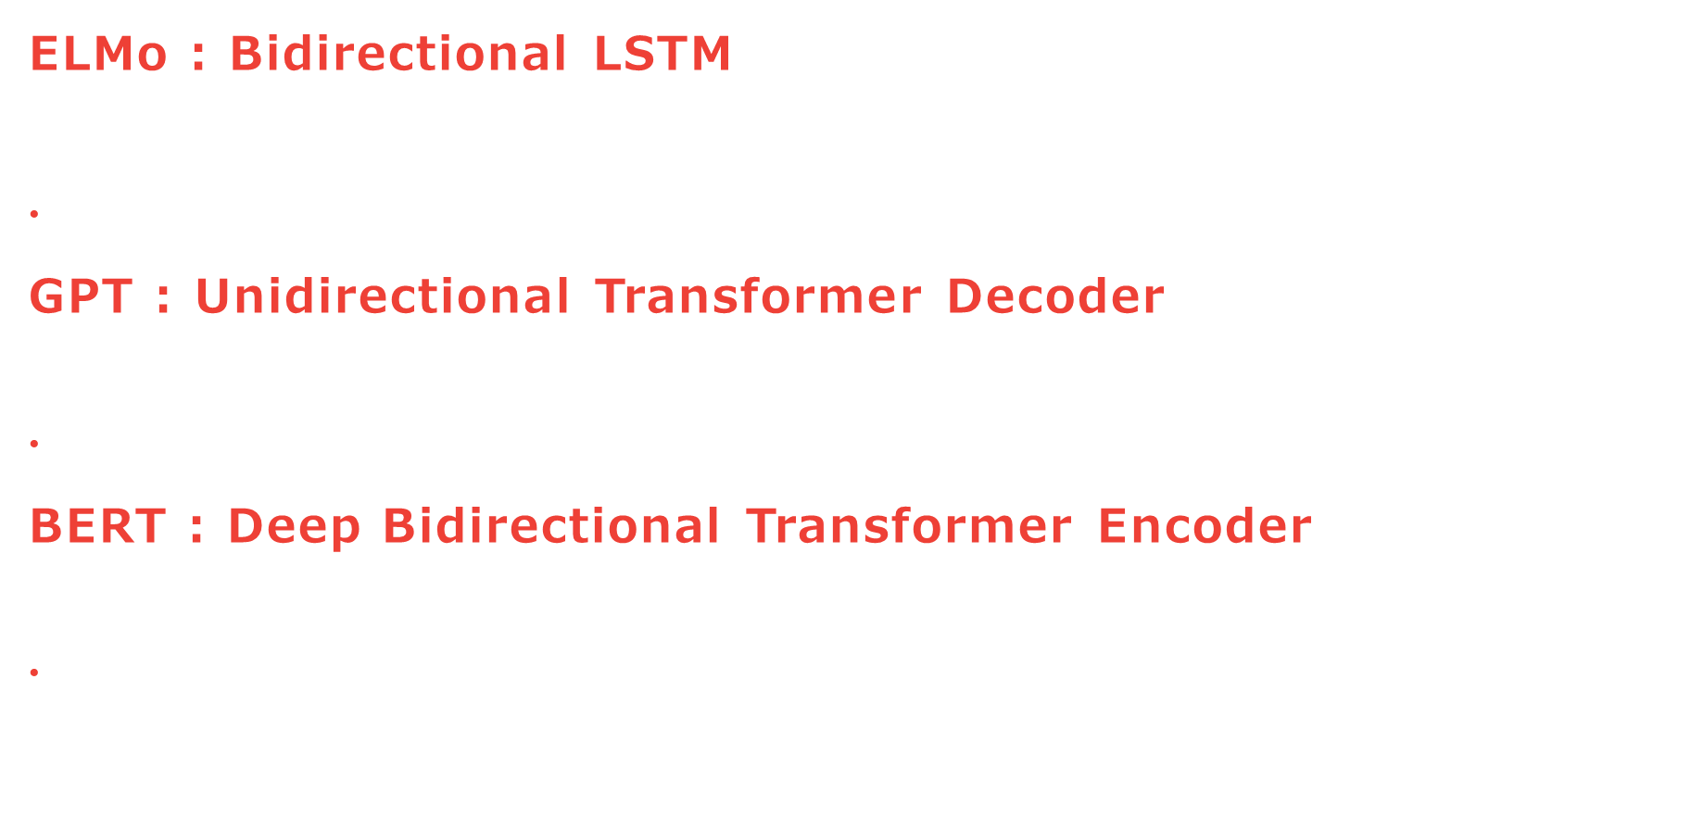
ELMo vs. GPT vs. BERT
8
ELMo : Bidirectional LSTM
$←$ the $←$ cat $←$ sat $←$ (Reads R$→$L) && $→$ the $→$ cat $→$ sat $→$ (Reads L$→$R)
Words see context only from one side at a time. No integration of both dirs at once.
GPT : Unidirectional Transformer Decoder
$→$ the $→$ cat $→$ sat $→$ on $→$ the $→$ mat $→$
Each word can only “see” the words before it, not after.
BERT : Deep Bidirectional Transformer Encoder
$↔$ the $↔$ [MASK] $↔$ sat $↔$ on $↔$ the $↔$ mat
It uses both left and right context at the same time.
Notes:
Notes :
ELMo reads from LTR and RTL, doesn’t share communicate in between however. Like if two people read a paragraph, one front to back, one back to front, then give their notes on it, but don’t ever discuss.
GPT reading from LTR, only context is words before it. Trying to predict next word.
BERT uses both LTR and RTL contexts at the same time, utilizing [MASK] to cover up the actual word and allow the model to make predictions.

Slide 9
ELMo vs. GPT vs. BERT
9
Model | Context Type | Pretraining Mask | Used For | Limitations
ELMo | LTR + RTL Concat | LM (No Mask) | Feature Extraction | Shallow fusion, no fine-tuning
GPT | LTR Only | LM (Next Word) | Task-specific Fine-tuning | Can’t use right context
BERT | Deep Bidirectional | MLM + NSP | Task-specific Fine-tuning | Higher training cost, slower inference
Why BERT Wins :
BERT was the first to use deep two-way context and support easy fine-tuning — helping it outperform past models on tasks like question answering and sentiment analysis.
Notes:
Notes :
ELMO – LTR & RTL separately, Notes concatenated, Language Model using No Mask, Used for extracting features from Language.
GPT – LTR Only, Focuses on next work in Language Model, Used for task-specific things if fine-tuned, Right Context refers to context to the right of word to be predicted.
BERT – LTR & RTL at same time, Masking, and Next Sentence Prediction, Can be used for variety of things like GPT but requires some fine tuning, it does take more time and resources to generate an output compared to a lighter model like GPT.
BERT – Outperforms.

Slide 10
Conclusion & Key Takeaways
10
What BERT did.
Introduced deep bidirectional pretraining using Masked LM and Next Sentence Prediction.
Impact.
Achieved SOTA on 11 NLP Tasks.
Outperformed humans on some benchmarks (e.g. SQuAD)
Legacy.
Inspired successors like RoBERTa, ALBERT, DistilBERT, and T5.
Key Insight.
Pretraining on full context + minimal fine-tuning = strong general NLP performance
Notes:
Notes :
Deep – Depth of the Neural Network, More Abstraction, More Automatic Learning.
Masked LM – “Guess the missing word?” , Randomly hides words and encourages model to predict original word using context from both sides.
Next Sentence Prediction – “Do these two sentences go together?” , Given two sentences, determine if Sentence B actually follows Sentence A.
11 NLP Tasks include SQuAD , SWAG , which are really just basic processes like answering questions based on a passage, Commonsense Reasoning.
Legacy – Different optimizations of BERT used for extensions in different ways, RoBERTa, has better performance on NLP benchmarks.
BERT is already pretrained on a large set of context + a little bit of fine-tuning for task at hand = strong NLP performance.

